Slide 1
Using Permutation and Combination to Solve Probability Problems

Slide 2

In this section, we’ll see how to use permutation and combination to solve probability problems.

Slide 3

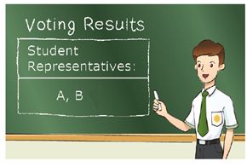
Take the election of student representatives as an example.
Suppose there are 5 candidates and each of them has equal chance of being elected as a student representative.
A B C D E
If 2 student representatives are to be elected,
the order in which the 2 candidates are selected is not important.
5
Then, the number of possible ways is
= 10.
C
2
Therefore, the probability that candidates A and B are elected is
1
1
=
Selecting A and B is one of the
possible ways.
C
5
10
2
C
5
2

Slide 4
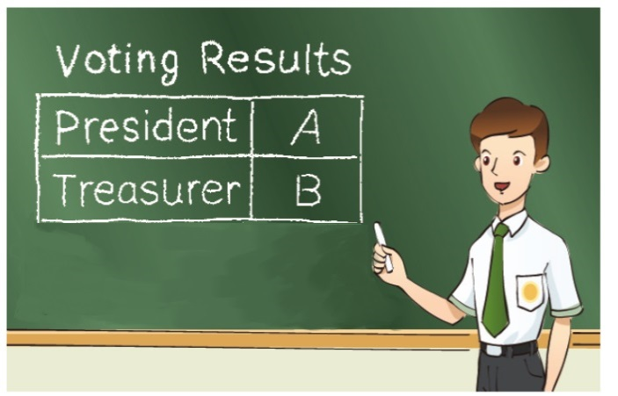


Take the election of student representatives as an example.
Suppose there are 5 candidates and each of them has equal chance of being elected as a student representative.
A B C D E
However, if a President and a Treasurer are to be elected from the 5 candidates,
the order in which the 2 candidates are selected is important.
5
Then, the number of possible ways is
= 20.
P
2
Therefore, the probability that candidates A and B are elected as the President and Treasurer respectively is
1
1
5
=
P
2
20

Slide 5
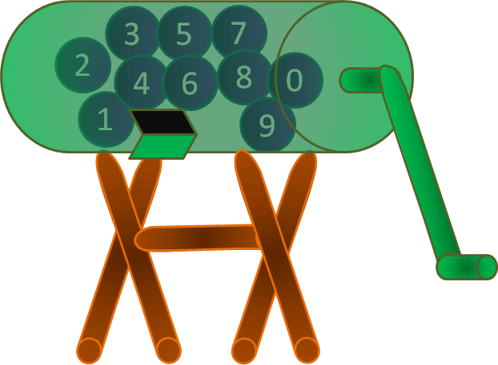
Follow-up question
In a game, there are 10 balls numbered from 0 to 9 in a lottery box. The host of the game draws three balls from the lottery box one by one without replacement. A player has to guess the three numbers on the balls drawn. Find the probabilities that
the player guesses all the three numbers drawn by the host
correctly in order,
(b) none of the three numbers guessed by the player is drawn by
the host.

Slide 6
Number of ways of drawing 3 balls from 10 balls in which
the order is important
= P
10
3
1
1
∴ The required probability =
=
P
10
720
3
10
(b) Number of ways of drawing 3 balls from 10 balls
= C
3
Number of ways that none of the three numbers guessed
by the player is drawn by the host
= C
7
3
∴ The required probability
C
7
7
=
3
=
C
10
24
3

